Slide 1
AVL Trees
COMP 282
Mahdi Ebrahimi
Slide Courtesy : ilhelm HarDouglas Wder, MMath, UWaterloo
dwharder@alumni.uwaterloo.ca

Slide 2
Balancing Binary Search Trees

Slide 3
BST: Efficiency of Operations?
Problem:
Worst-case running time:
find, insert, delete

Slide 4
How can we make a BST efficient?
Observation
Solution: Require a Balance Condition that
When we build the tree, make sure it’s balanced.
BUT…Balancing a tree only at build time is insufficient.
We also need to also keep the tree balanced as we perform operations.

Slide 5
Binary search trees store linearly ordered data
Best case height: Ο(log(n))
Worst case height: O(n)
Requirement:
Define and maintain a balance to ensure Ο(log(n)) height
https://en.wikipedia.org/wiki/Self-balancing_binary_search_tree

Slide 6
AVL Tree (Bonus material: etymology)
Invented by Georgy Adelson-Velsky and Evgenii Landis in 1962

Slide 7
AVL Trees
Balance is defined by comparing the height of the two sub-trees
Recall:
An empty tree has height –1
A tree with a single node has height 0

Slide 8
AVL Trees
A binary search tree is said to be AVL balanced if:
The difference in the heights between the left and right sub-trees is at most 1, and
Both sub-trees are themselves AVL trees

Slide 9
Definition for Balance
We must develop a quantitative definition of balance which can be applied
Balanced may be defined by:
Height balancing: comparing the heights of the two sub trees
Null-path-length balancing: comparing the null-path-length of each of the two sub-trees (the length to the closest null sub-tree/empty node)
Weight balancing: comparing the number of null sub-trees in each of the two sub trees
Mathematically it can proved that if a tree satisfies the definition of balance, its height is Ο(ln(n))

Slide 10
The AVL Tree Data Structure
An AVL tree is a self-balancing binary search tree.
Structural properties
Binary tree property (same as BST)
Order property (same as for BST)
Balance condition: balance of every node is between -1 and 1 (-1, 0 , 1) where balance(node/factor) = height(node.left) – height(node.right)
https://en.wikipedia.org/wiki/Self-balancing_binary_search_tree

Slide 11
Example #1: Is this an AVL Tree?
Balance Condition: balance of every node is between -1 and 1 where balance(node) = height(node.left) – height(node.right)
6
4
8
1
7
11
10
12

Slide 12
Example #2: Is this an AVL Tree?
6
Balance Condition: balance of every node is between -1 and 1 where balance(node) = height(node.left) – height(node.right)
4
8
1
5
7
11
3
2

Slide 13
AVL Trees
Good News:
Because height of AVL tree is O(log(n)), then find
But as we insert and delete elements, we need to:

Slide 14
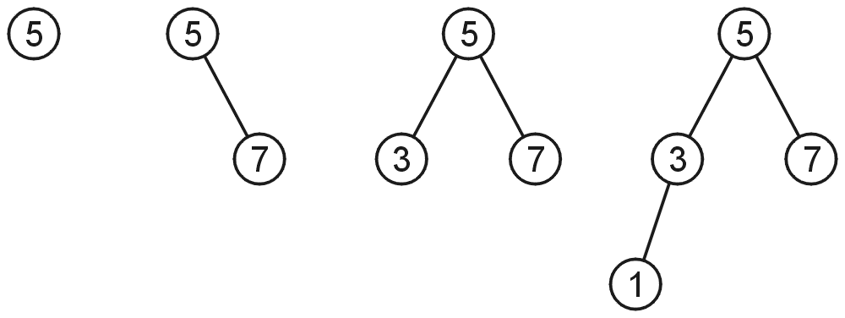
AVL Trees
AVL trees with 1, 2, 3, and 4 nodes:

Slide 15
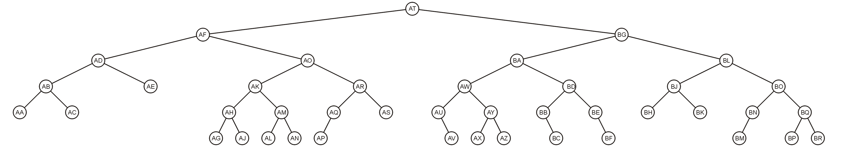
AVL Trees
Here is a larger AVL tree (42 nodes):

Slide 16
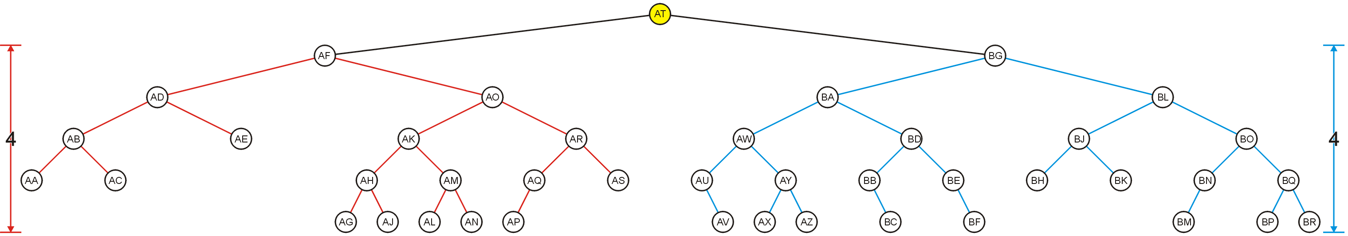
AVL Trees
The root node is AVL-balanced:
Both sub-trees are of height 4:

Slide 17
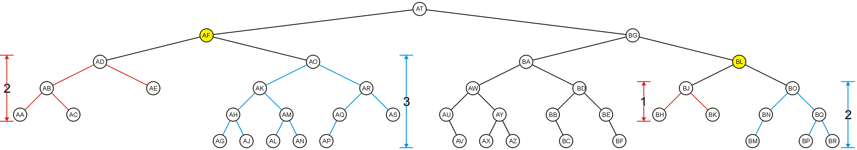
AVL Trees
All other nodes are AVL balanced
The sub-trees differ in height by at most one

Slide 18
Height of an AVL Tree
By the definition of complete trees, any complete binary search tree is an AVL tree
Thus an upper bound on the number of nodes in an AVL tree of height h a perfect binary tree with 2^{h + 1} – 1 nodes
What is an lower bound?

Slide 19
Height of an AVL Tree
Let F(h) be the fewest number of nodes in a tree of height h
From a previous slide:
F(0) = 1
F(1) = 2
F(2) = 4
Can we find F(h)?

Slide 20
Height of an AVL Tree
The worst-case AVL tree of height h would have:
A worst-case AVL tree of height h – 1 on one side,
A worst-case AVL tree of height h – 2 on the other, and
The root node
We get: F(h) = F(h – 1) + 1 + F(h – 2)

Slide 21
Height of an AVL Tree
This is a recurrence relation:
The solution?

Slide 22
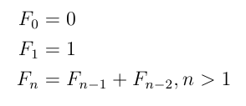
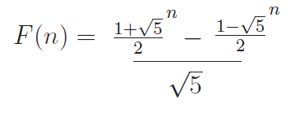
Fibonacci Numbers

Slide 23
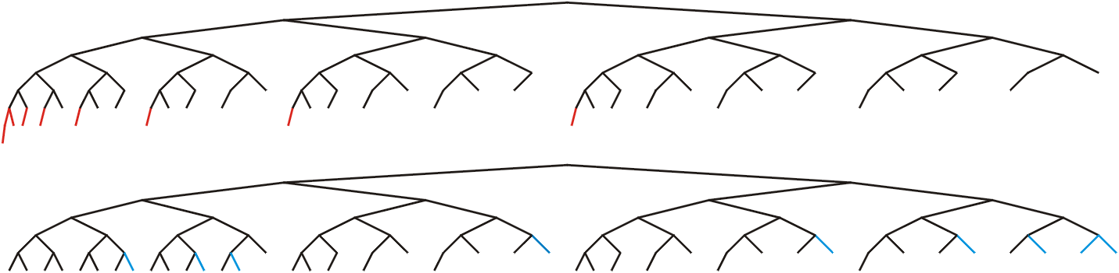
Height of an AVL Tree
In this example, n = 88, the worst- and best-case scenarios differ in height by only 2

Slide 24
Height of an AVL Tree
Fact: The height of an AVL tree storing n keys is O(log n).
Proof: Let us bound n(h): the minimum number of internal nodes of an AVL tree of height h.
We easily see that n(1) = 1 and n(2) = 2
For n > 2, an AVL tree of height h contains the root node, one AVL subtree of height h-1 and another of height h-2.
That is, n(h) = 1 + n(h-1) + n(h-2)
Knowing n(h-1) > n(h-2), we get n(h) > 2n(h-2). So
n(h) > 2n(h-2), n(h) > 4n(h-4), n(h) > 8n(n-6), … (by induction),
n(h) > 2^{i}n(h-2i)
Solving the base case we get: n(h) > 2 ^{h/2-1}
Taking logarithms: h < 2log n(h) +2
Thus the height of an AVL tree is O(log n)
n(2)
3
4
n(1)

Slide 25
AVL tree operations
AVL find:
Same as usual BST find
AVL insert:
AVL delete:
The “easy way” is lazy deletion
Otherwise, do the deletion and then check for several imbalance cases

Slide 26
Maintaining Balance
To maintain AVL balance, observe that:
Inserting a node can increase the height of a tree by at most 1
Removing a node can decrease the height of a tree by at most 1

Slide 27
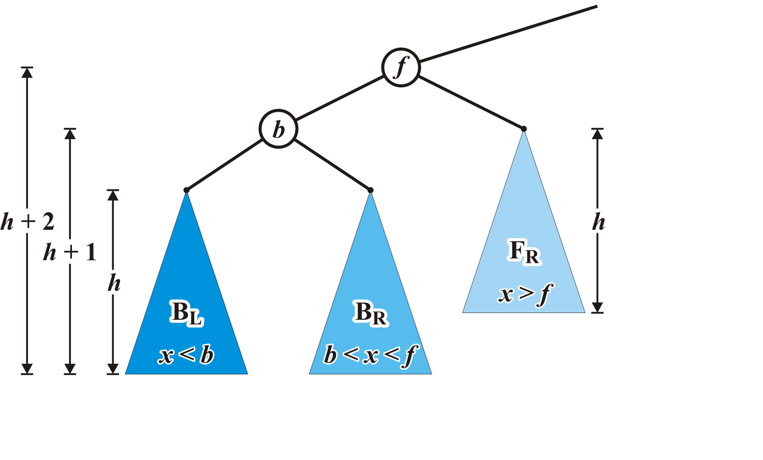
Case 1 setup
Consider the following setup
Each blue triangle represents a tree of height h

Slide 28
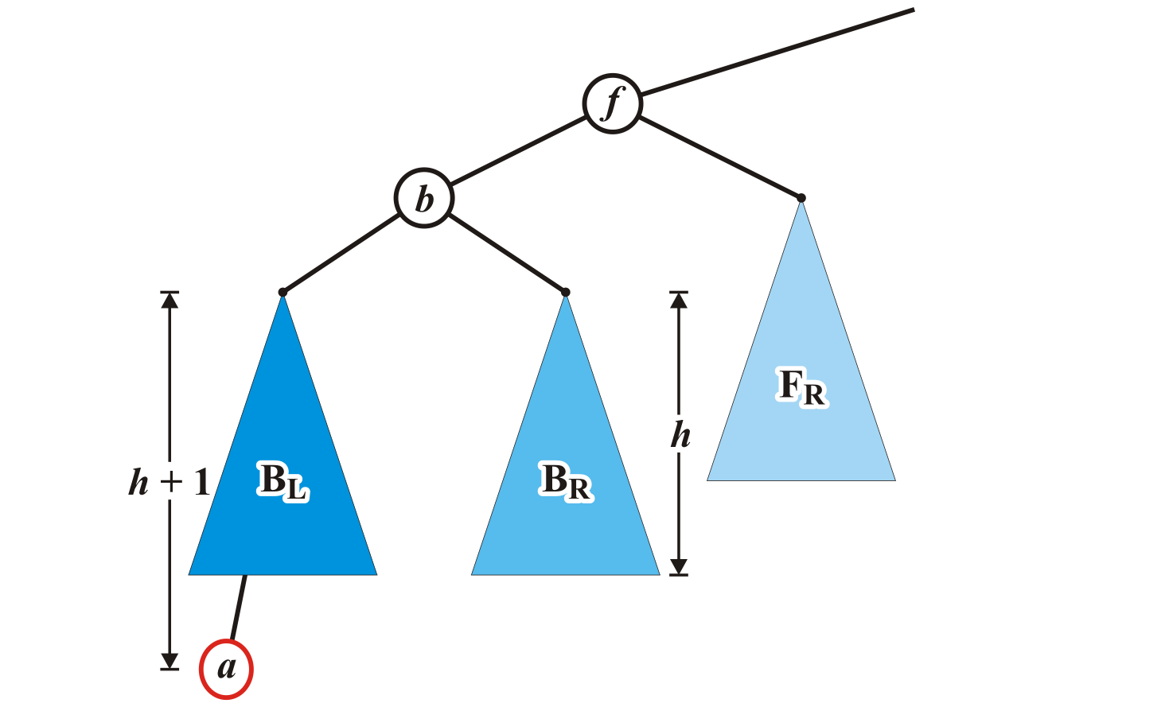
Maintaining Balance: Case 1
Insert a into this tree: it falls into the left subtree B_{L} of b
Assume B_{L} remains balanced
Thus, the tree rooted at b is also balanced
Left subtree of left child

Slide 29
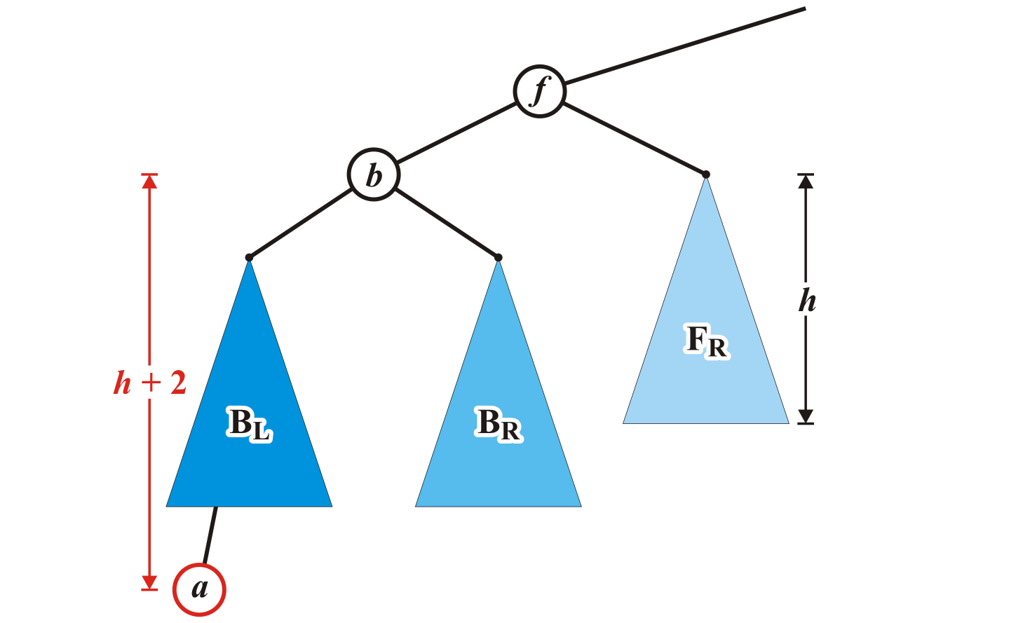
Maintaining Balance: Case 1
The tree rooted at node f is now unbalanced
We will correct the imbalance at this node

Slide 30
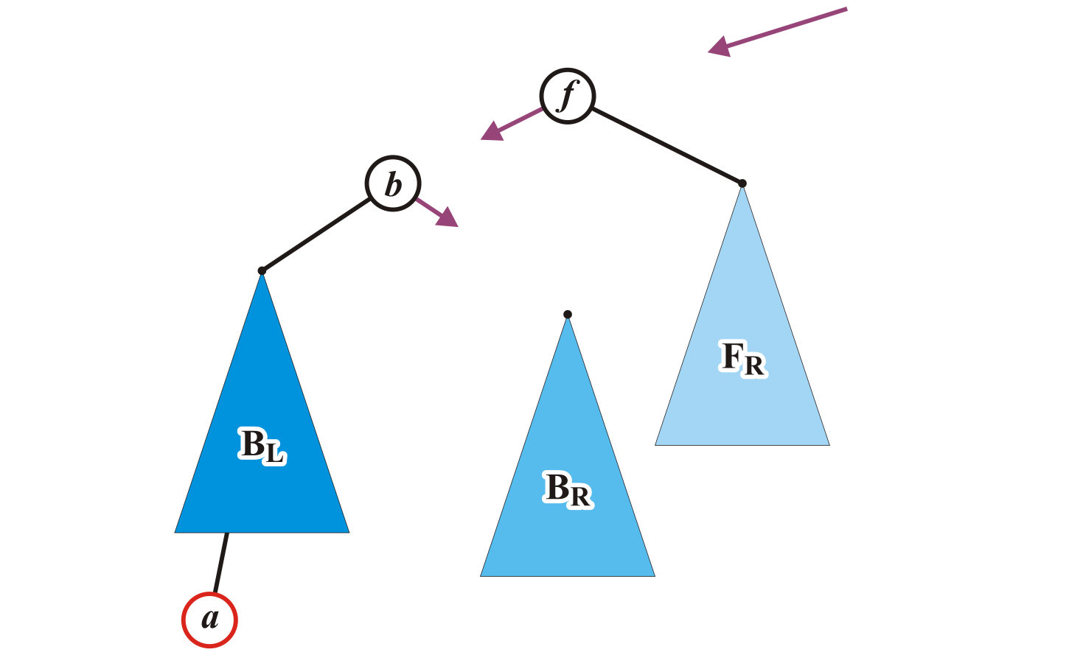
Maintaining Balance: Case 1
We will modify these three pointers:

Slide 31
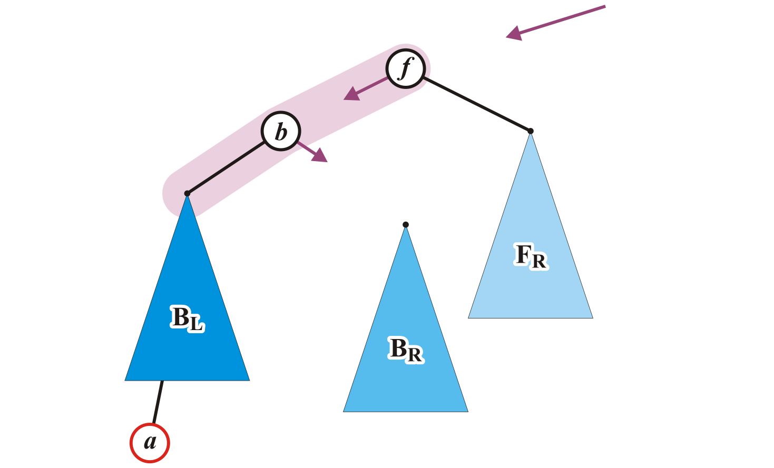
Maintaining Balance: Case 1
Specifically, we will rotate these two nodes around the root:
Recall the first prototypical example
Promote node b to the root and demote node f to be the right child of b

Slide 32
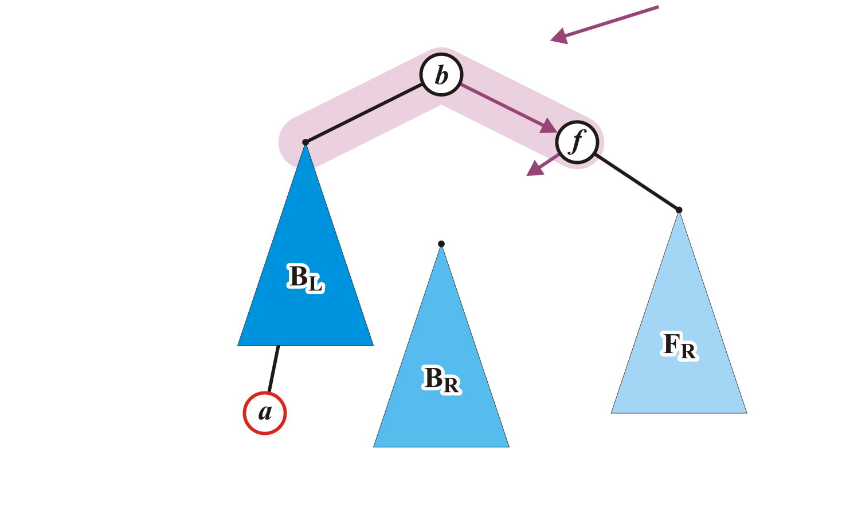
Maintaining Balance: Case 1
Make f the right child of b

Slide 33
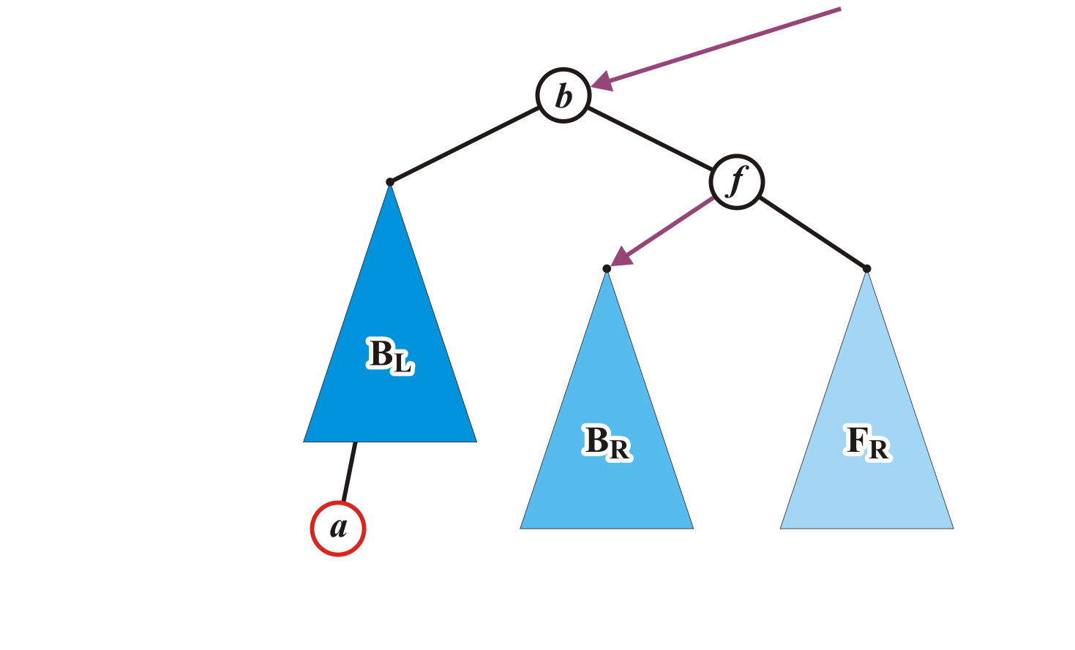
Maintaining Balance: Case 1
Assign former parent of node f to point to node b
Make B_{R} left child of node f

Slide 34
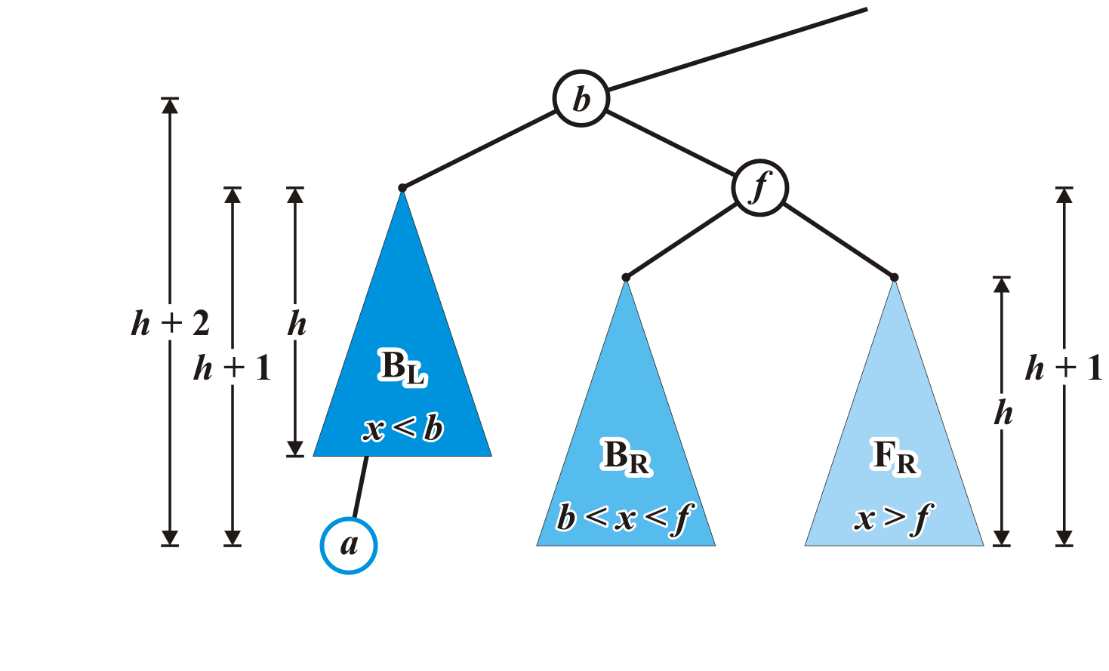
Maintaining Balance: Case 1
The nodes b and f are now balanced and all remaining nodes of the subtrees are in their correct positions

Slide 35
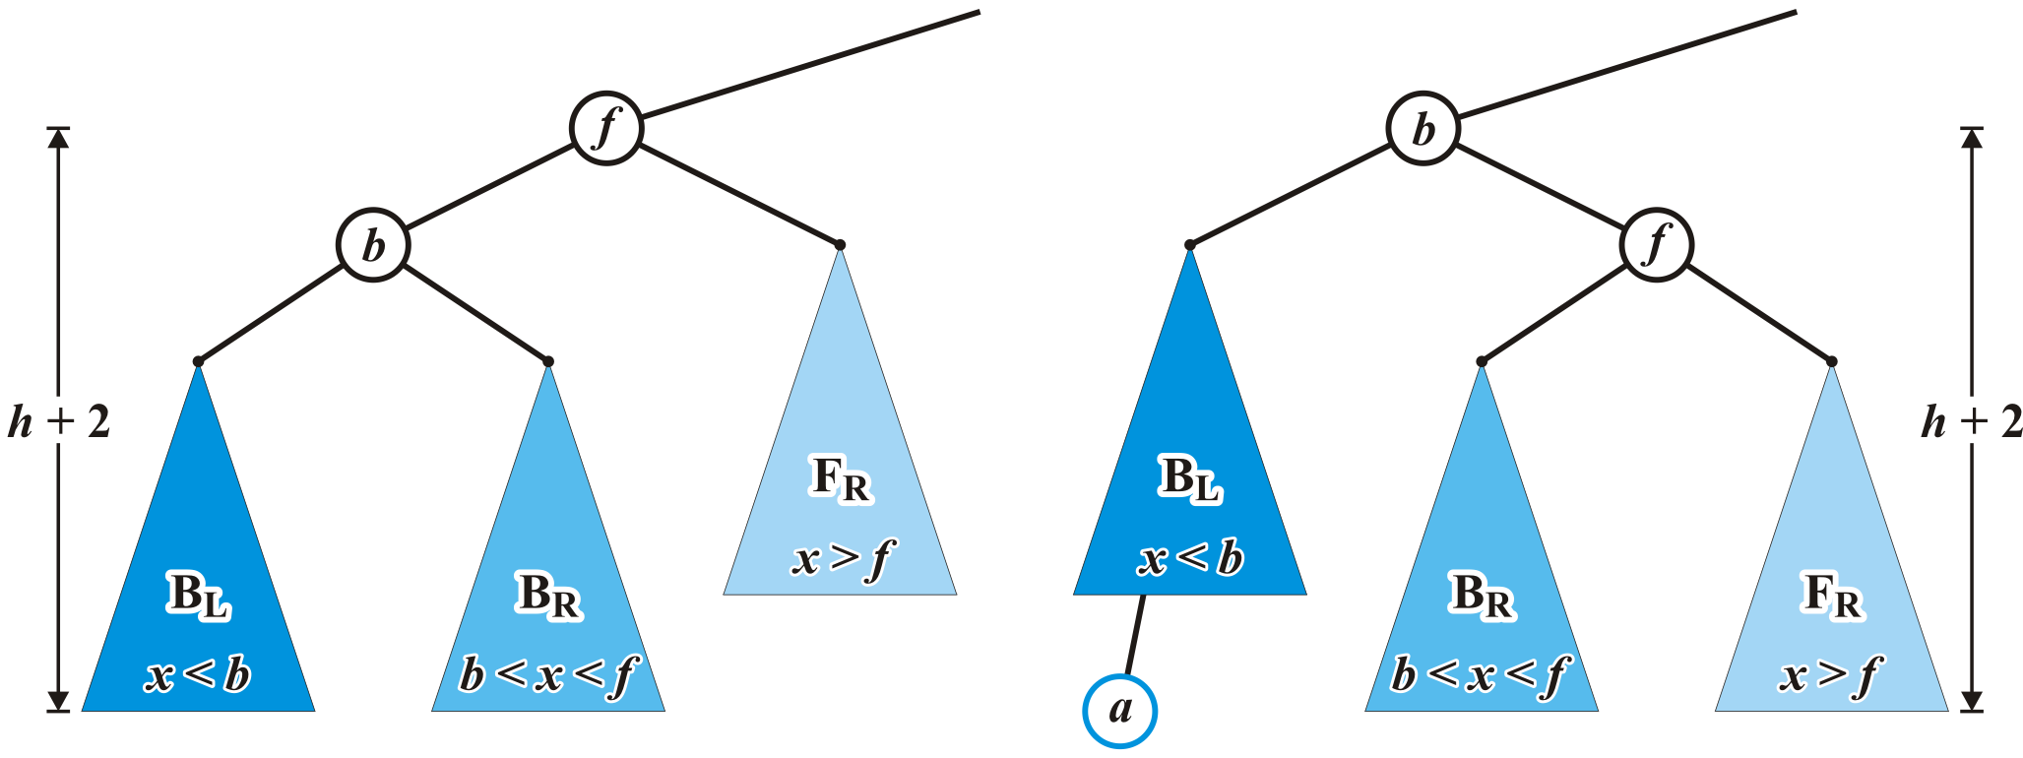
Maintaining Balance: Case 1
Additionally, height of the tree rooted at b equals the original height of the tree rooted at f
Thus, this insertion will no longer affect the balance of any ancestors all the way back to the root

Slide 36
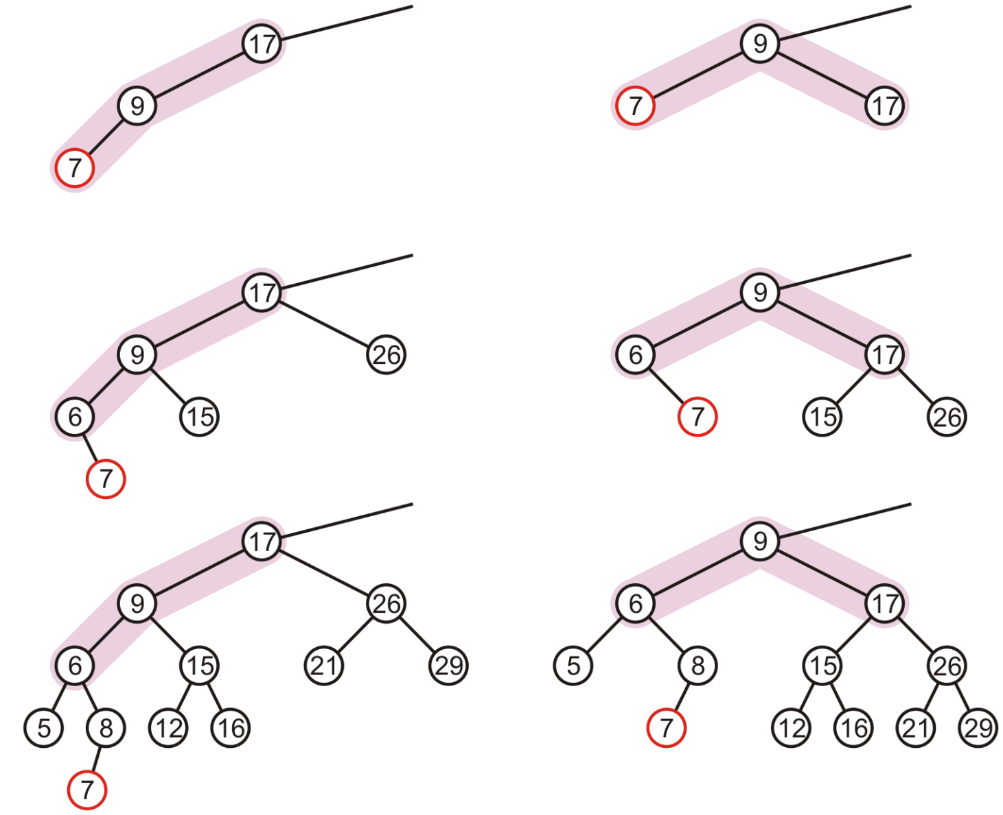
More Examples

Slide 37
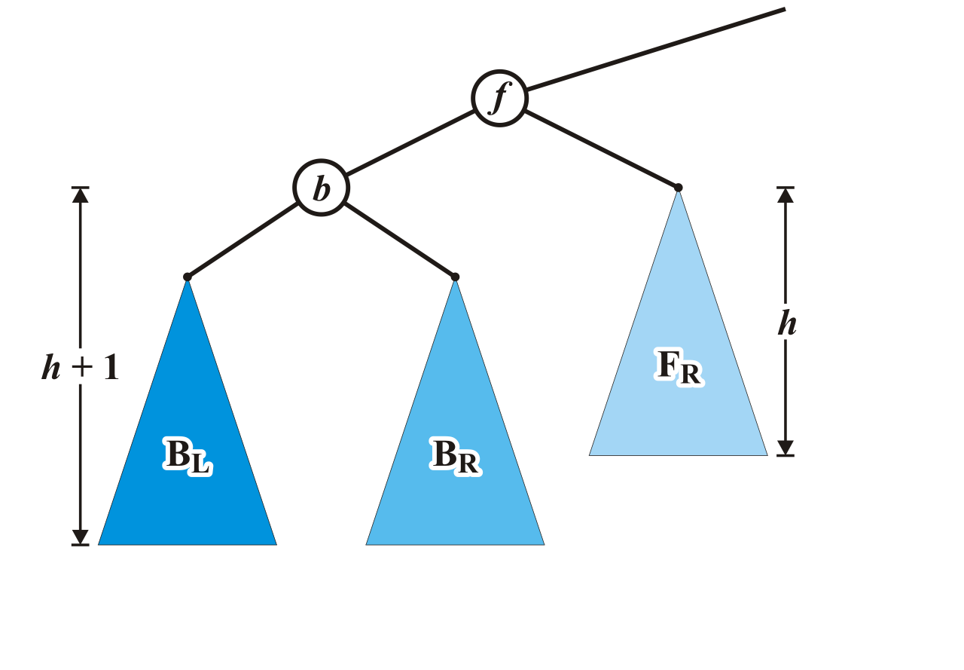
Maintaining Balance: Case 2
Alternatively, consider the insertion of c where b < c < f into our original tree

Slide 38
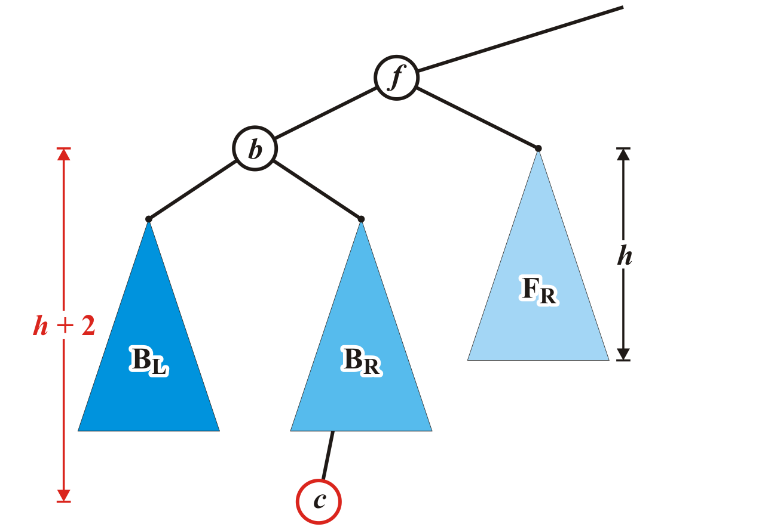
Maintaining Balance: Case 2
Assume that the insertion of c increases the height of B_{R}
Once again, f becomes unbalanced
Right subtree of left child

Slide 39
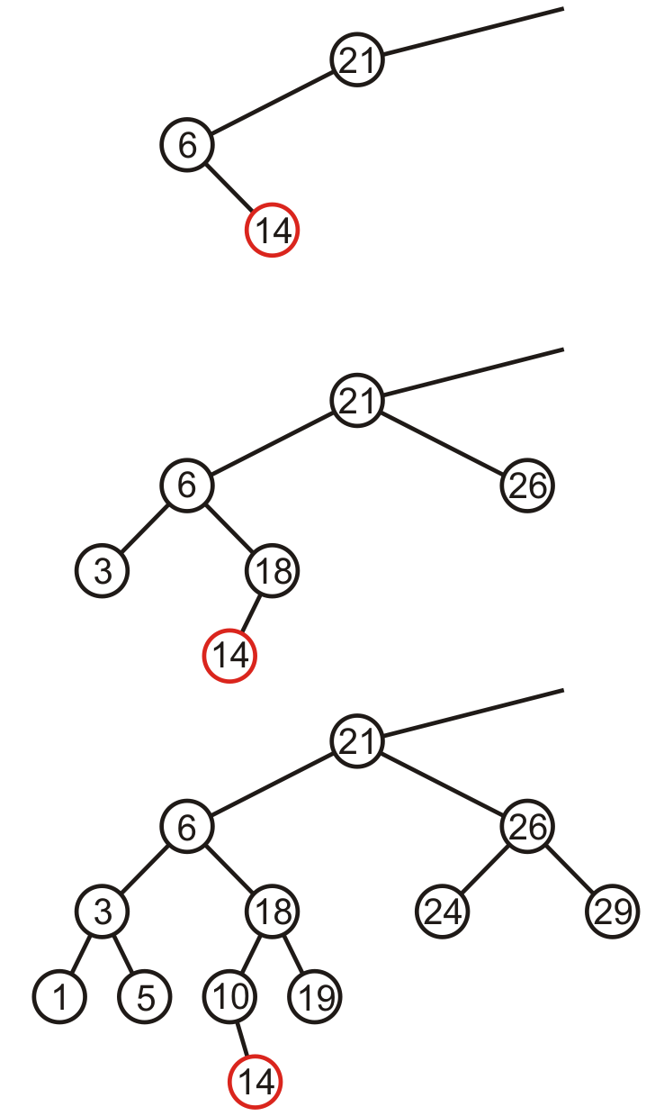
Maintaining Balance: Case 2
Here are examples of when the insertion of 14 may cause this situation when h = –1, 0, and 1

Slide 40
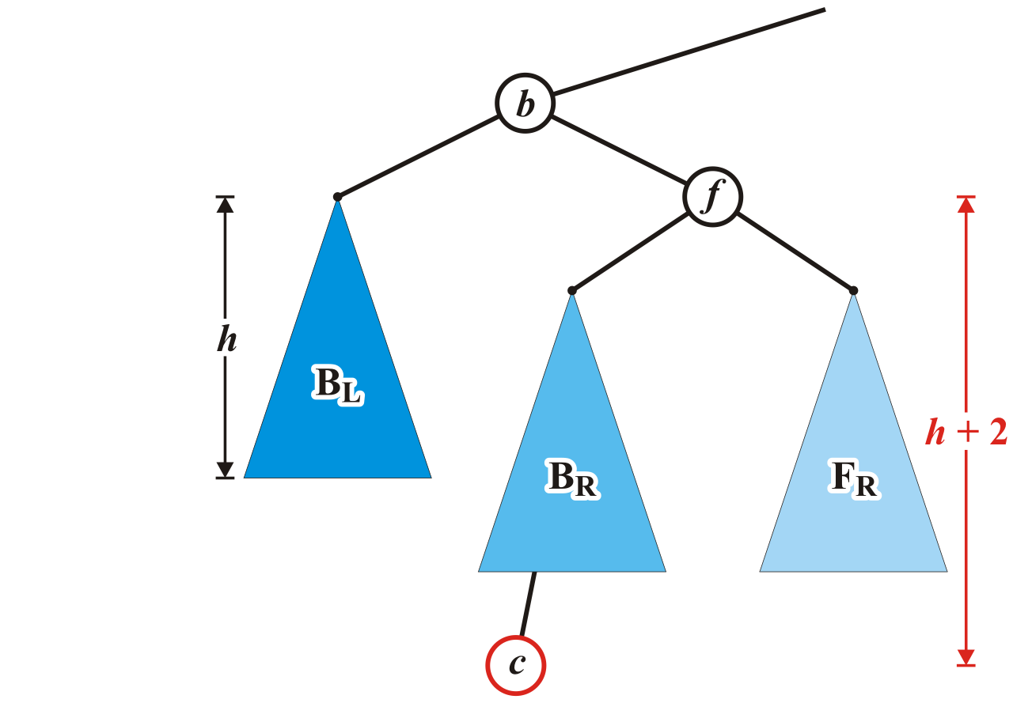
Maintaining Balance: Case 2
Unfortunately, the previous correction does not fix the imbalance at the root of this sub-tree: the new root, b, remains unbalanced

Slide 41
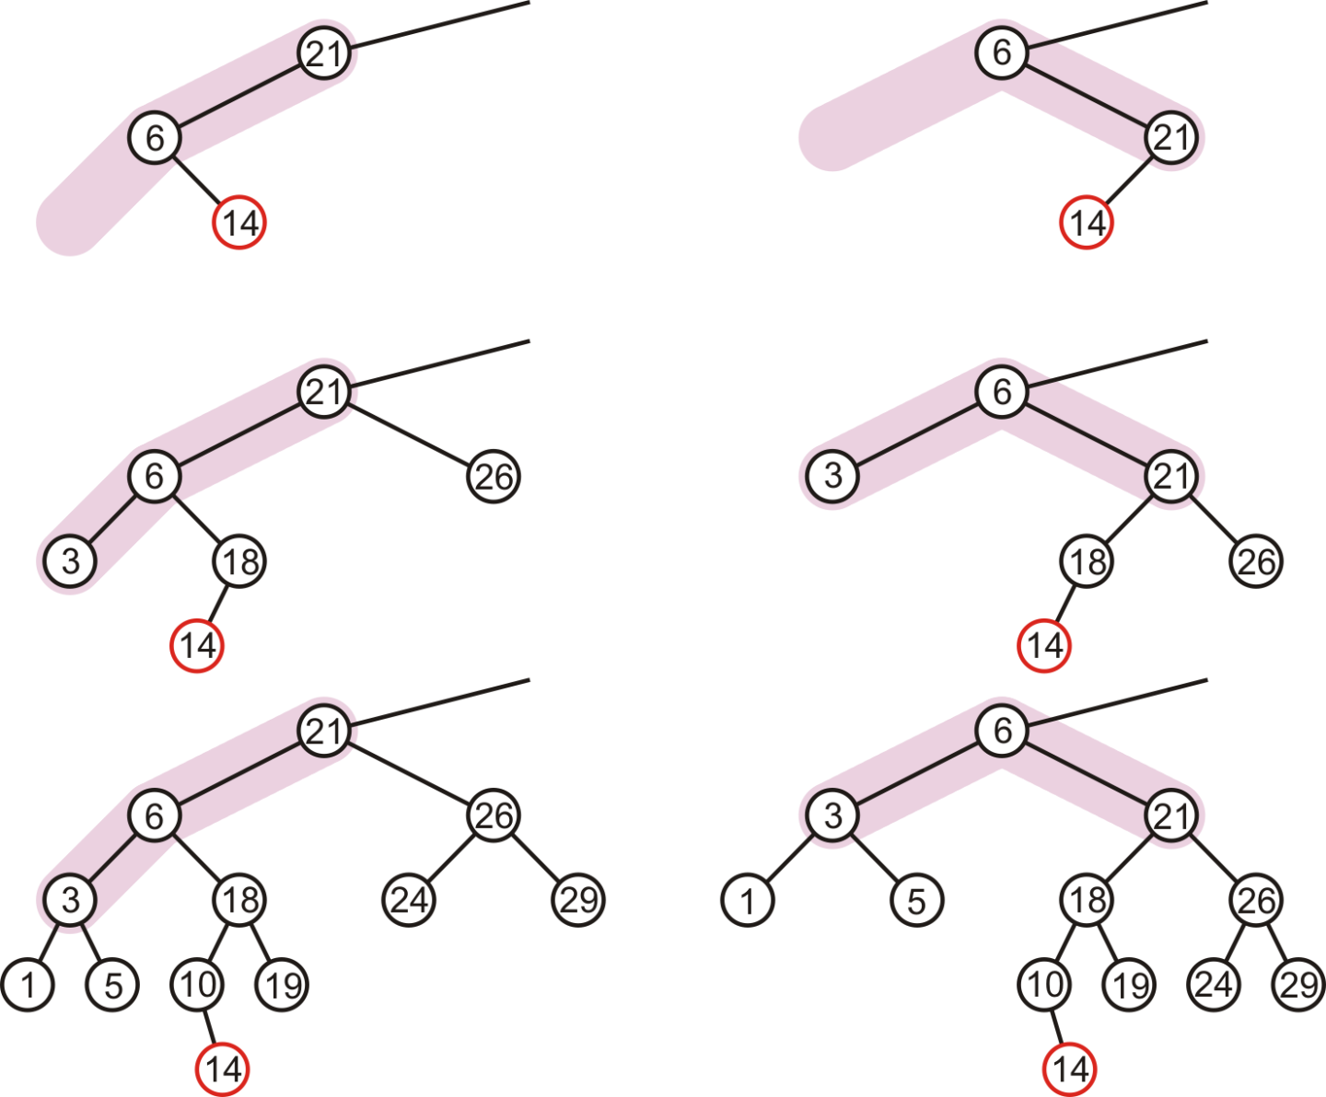
Maintaining Balance: Case 2
In our three sample cases with h = –1, 0, and 1, doing the same thing as before results in a tree that is still unbalanced…
The imbalance is just shifted to the other side

Slide 42
Maintaining Balance: Case 2
Lets start over …

Slide 43
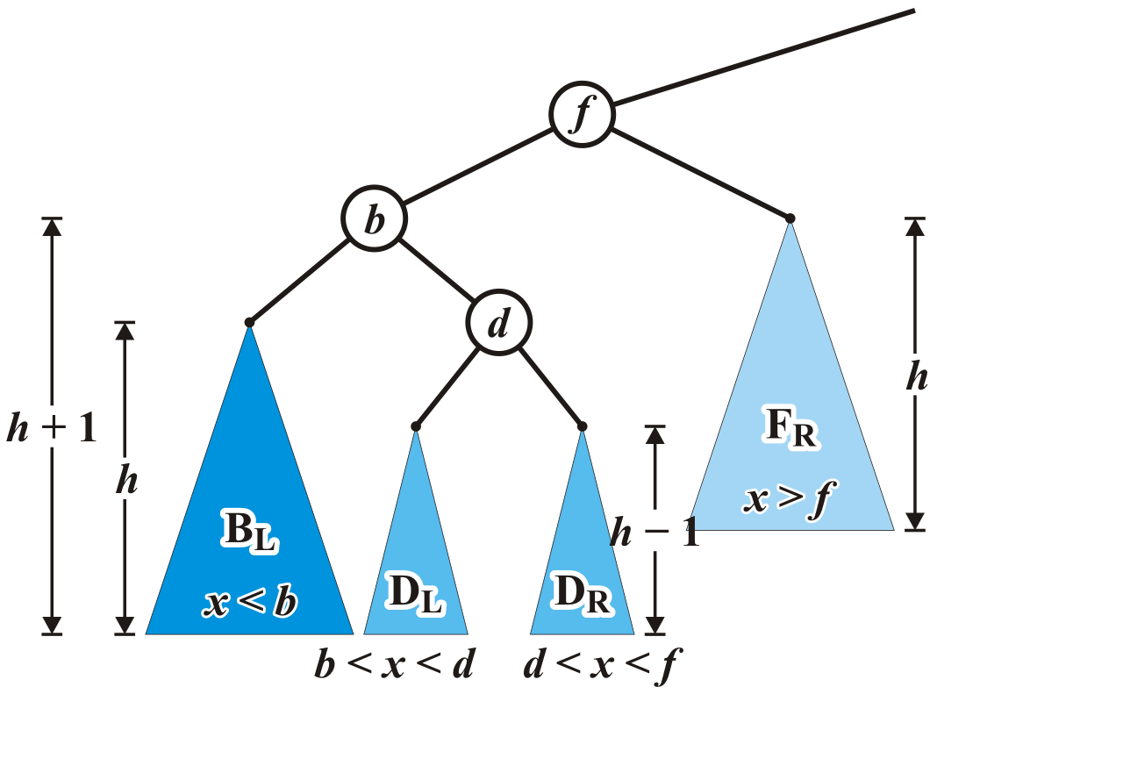
Maintaining Balance: Case 2
Re-label the tree by dividing the left subtree of f into a tree rooted at d with two subtrees of height h – 1

Slide 44
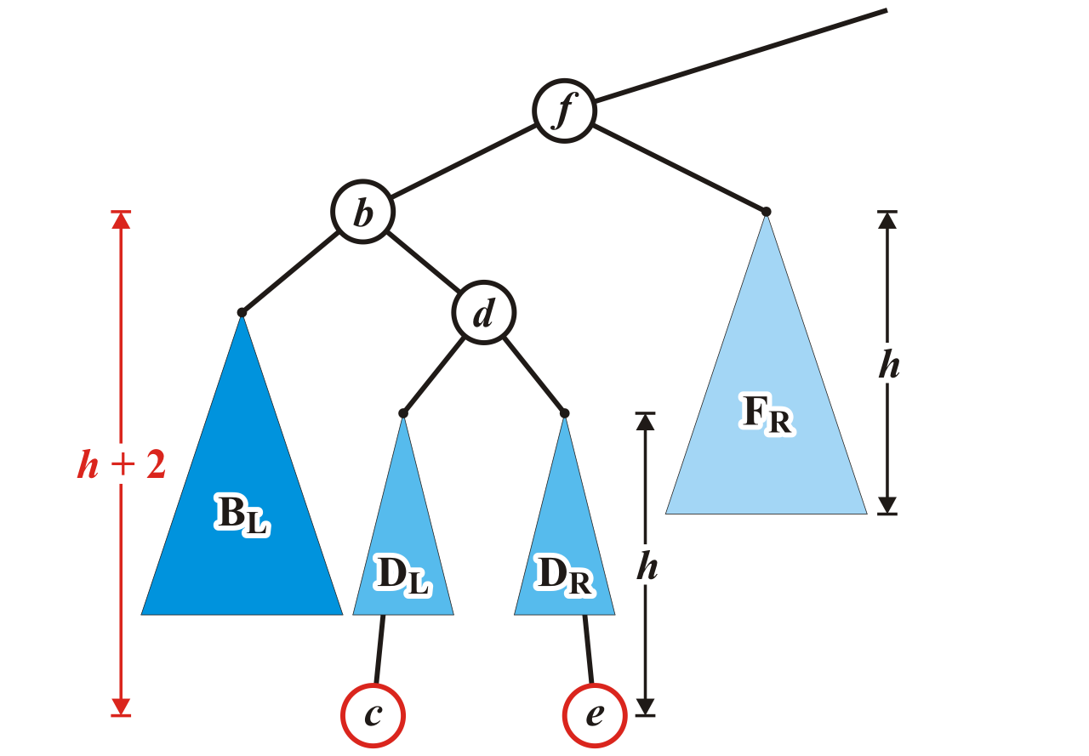
Maintaining Balance: Case 2
Now an insertion causes an imbalance at f
The addition of either c or e will cause this

Slide 45
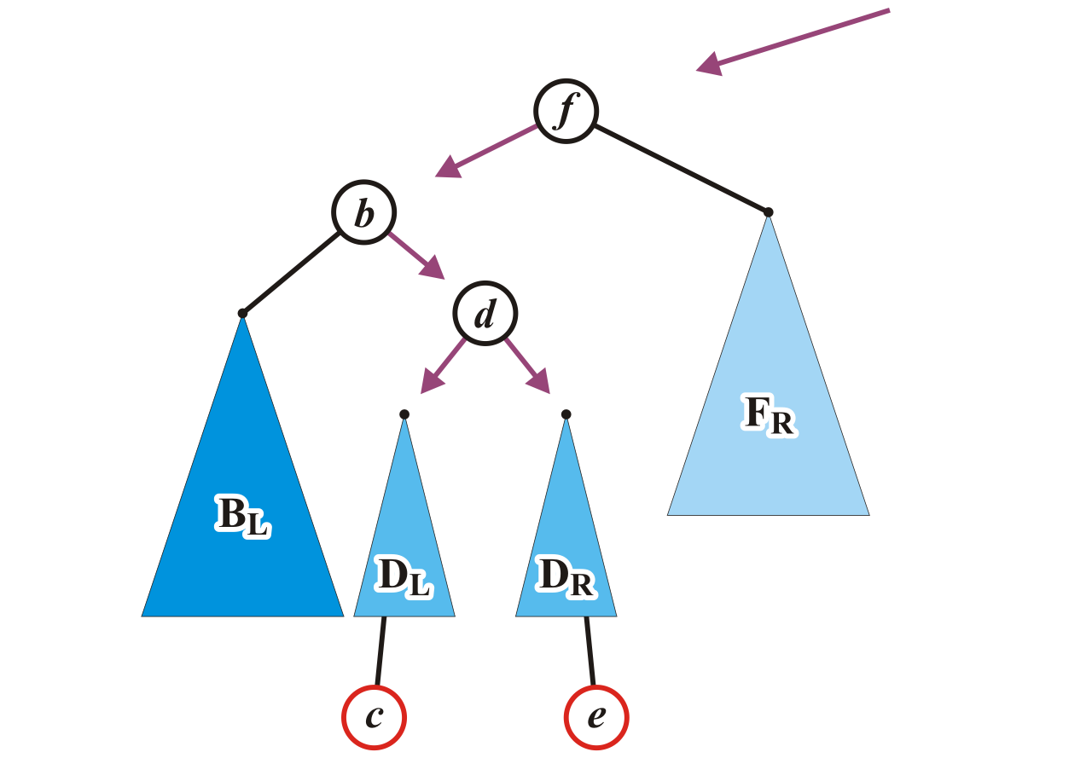
Maintaining Balance: Case 2
We will reassign the following pointers

Slide 46
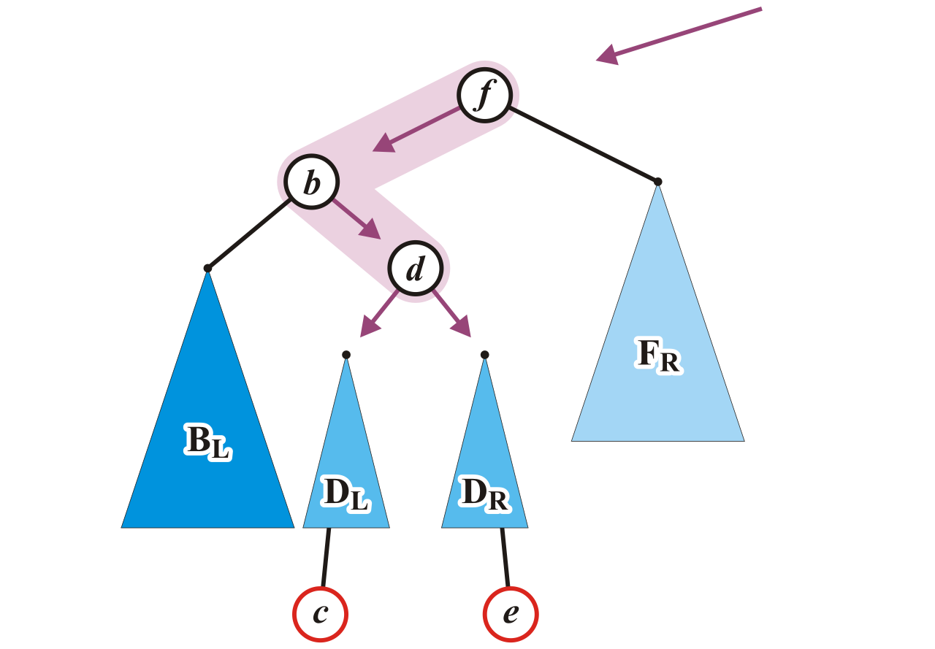
Maintaining Balance: Case 2
Specifically, we will order these three nodes as a perfect tree
Recall the second prototypical example

Slide 47
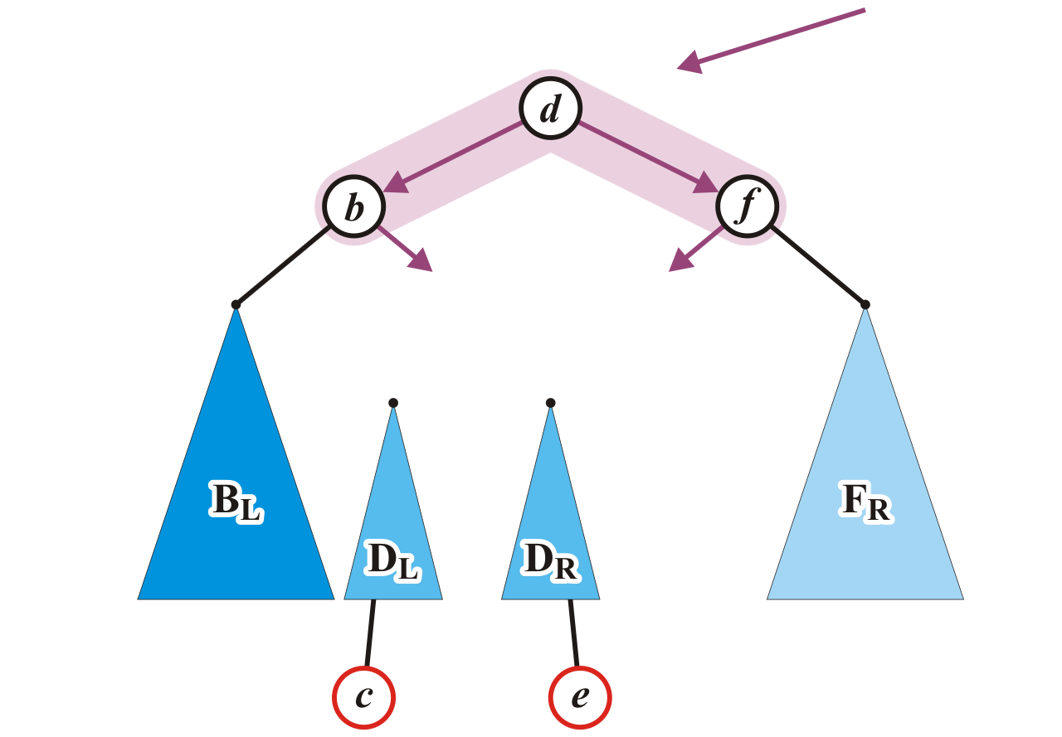
Maintaining Balance: Case 2
To achieve this, b and f will be assigned as children of the new root d

Slide 48
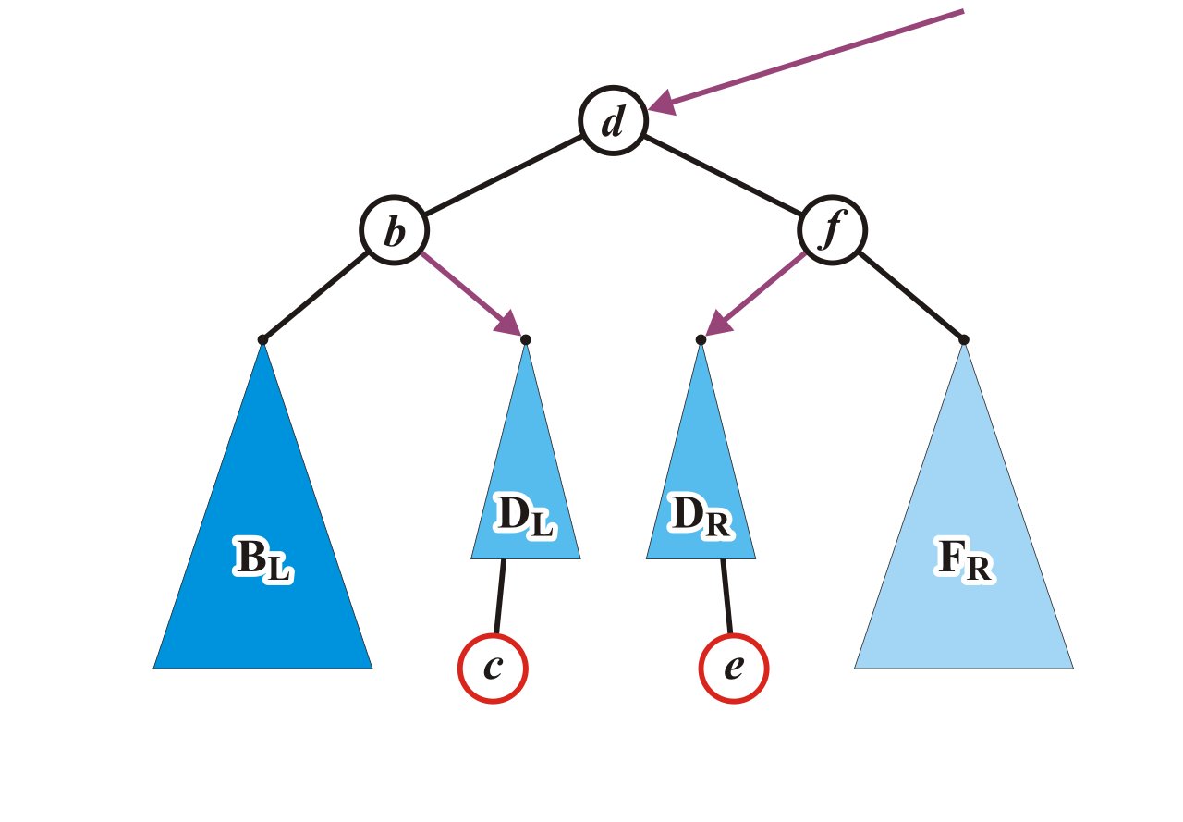
Maintaining Balance: Case 2
We also have to connect the two subtrees and original parent of f

Slide 49
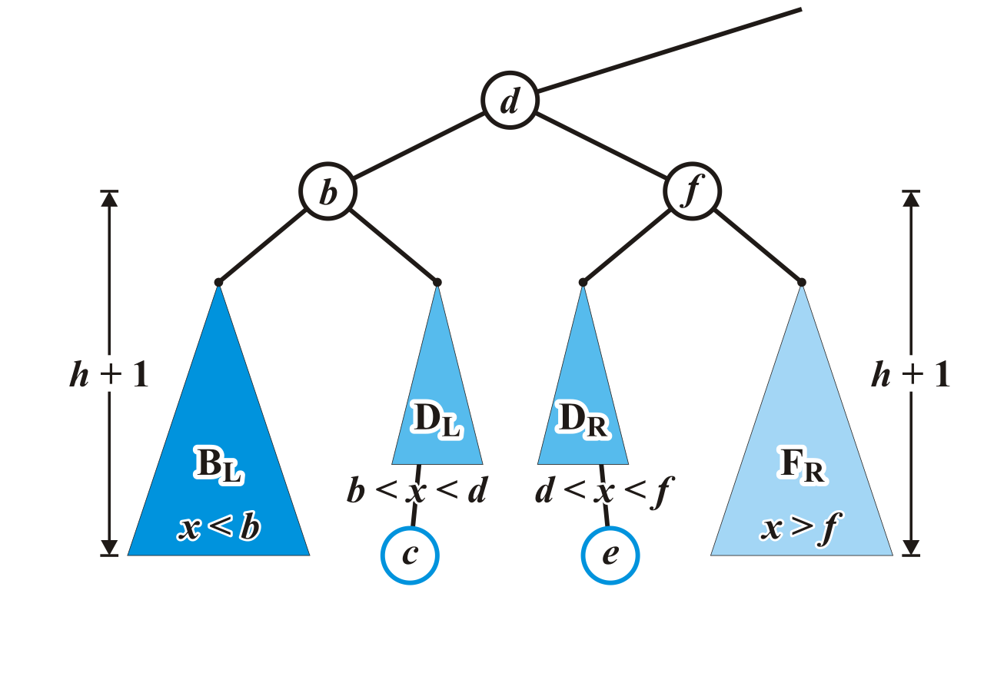
Maintaining Balance: Case 2
Now the tree rooted at d is balanced

Slide 50
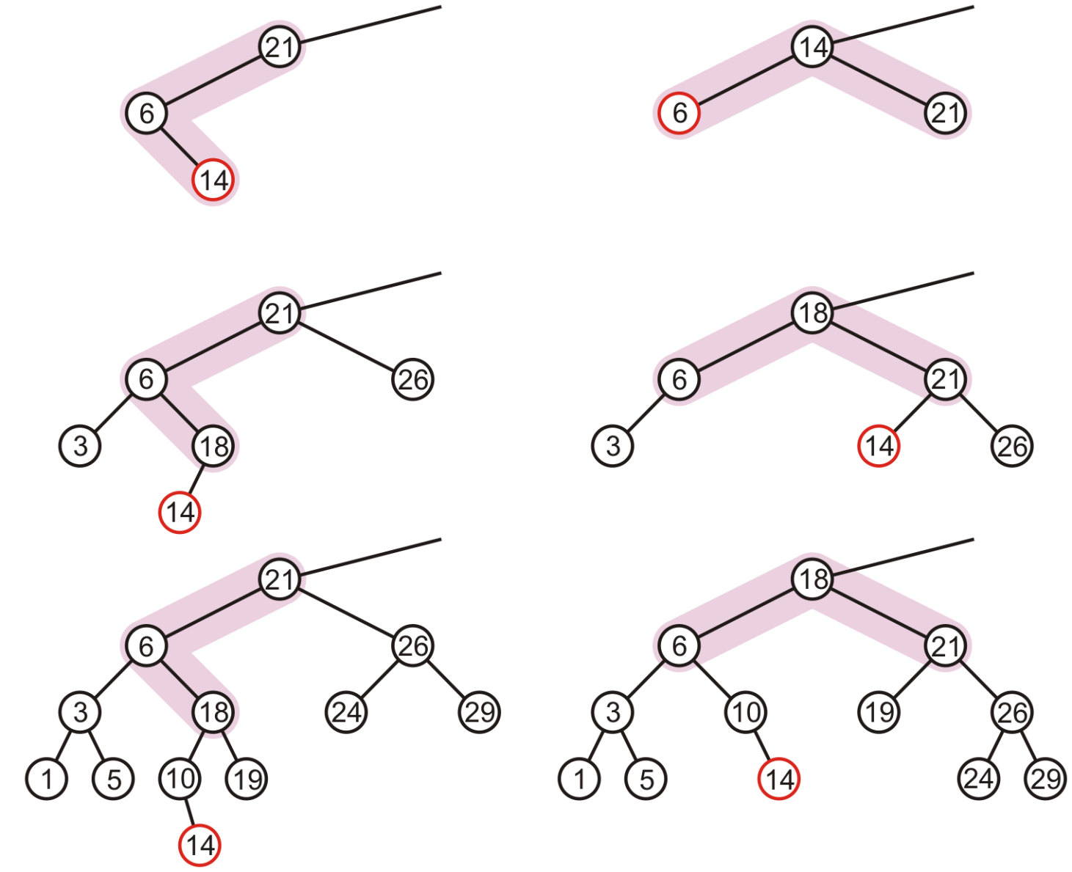
Maintaining Balance: Case 2
In our three sample cases with h = –1, 0, and 1, the node is now balanced and the same height as the tree before the insertion
14

Slide 51
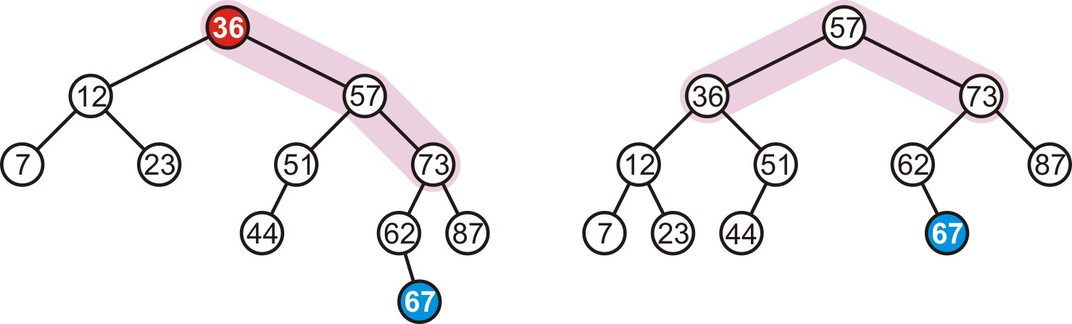
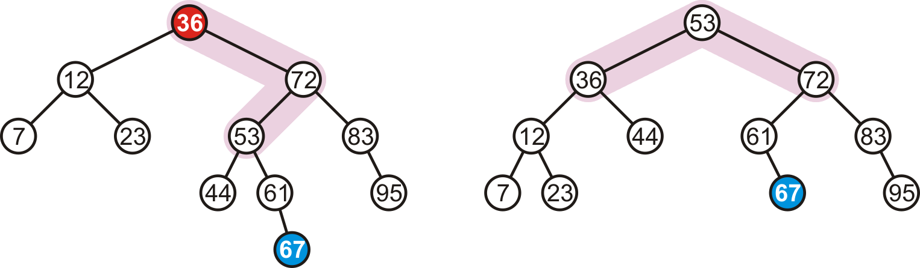
Maintaining balance: Summary
There are two symmetric cases to those we have examined:
Insertions into the right-right sub-tree
-- Insertions into either the right-left sub-tree

Slide 52
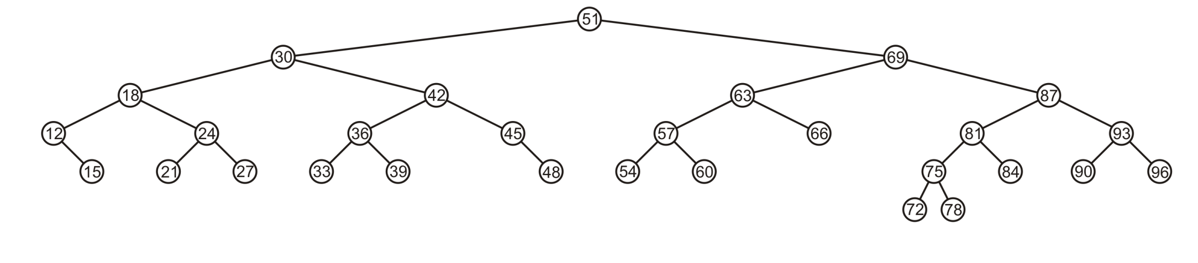
More examples : Insertion
Consider this AVL tree

Slide 53
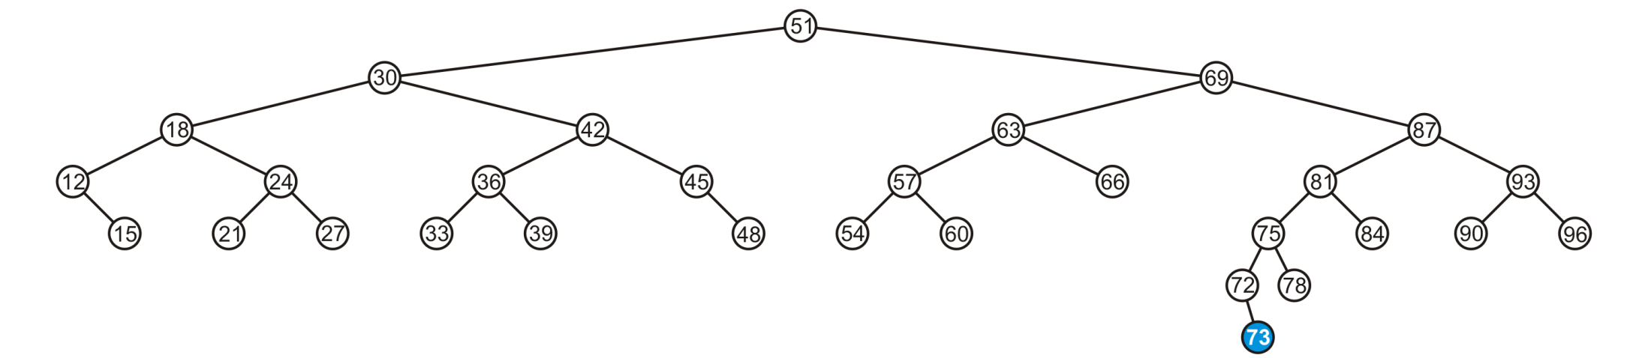
Insertion
Insert 73

Slide 54
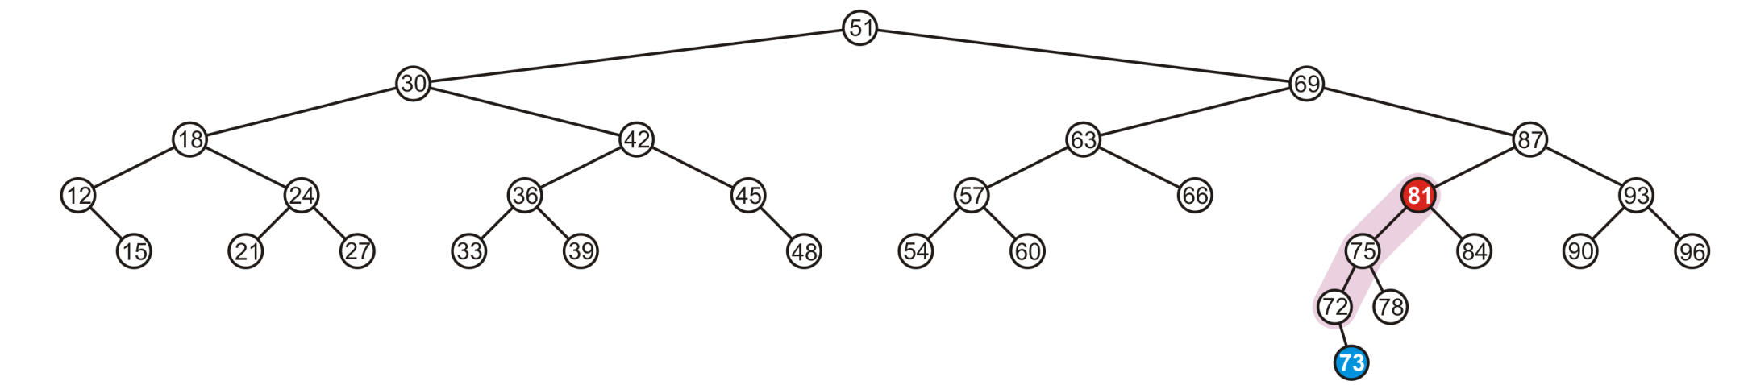
Insertion
The node 81 is unbalanced
A left-left imbalance

Slide 55
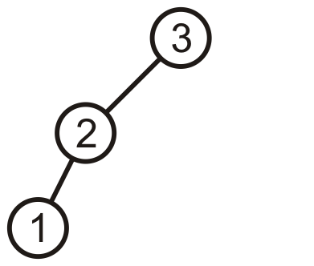
Insertion
The node 81 is unbalanced
A left-left imbalance

Slide 56
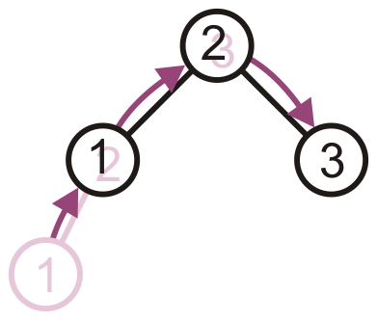
Insertion
The node 81 is unbalanced
A left-left imbalance
Promote the intermediate node to the imbalanced node

Slide 57
Insertion
The node 81 is unbalanced
A left-left imbalance
Promote the intermediate node to the imbalanced node
75 is that node

Slide 58
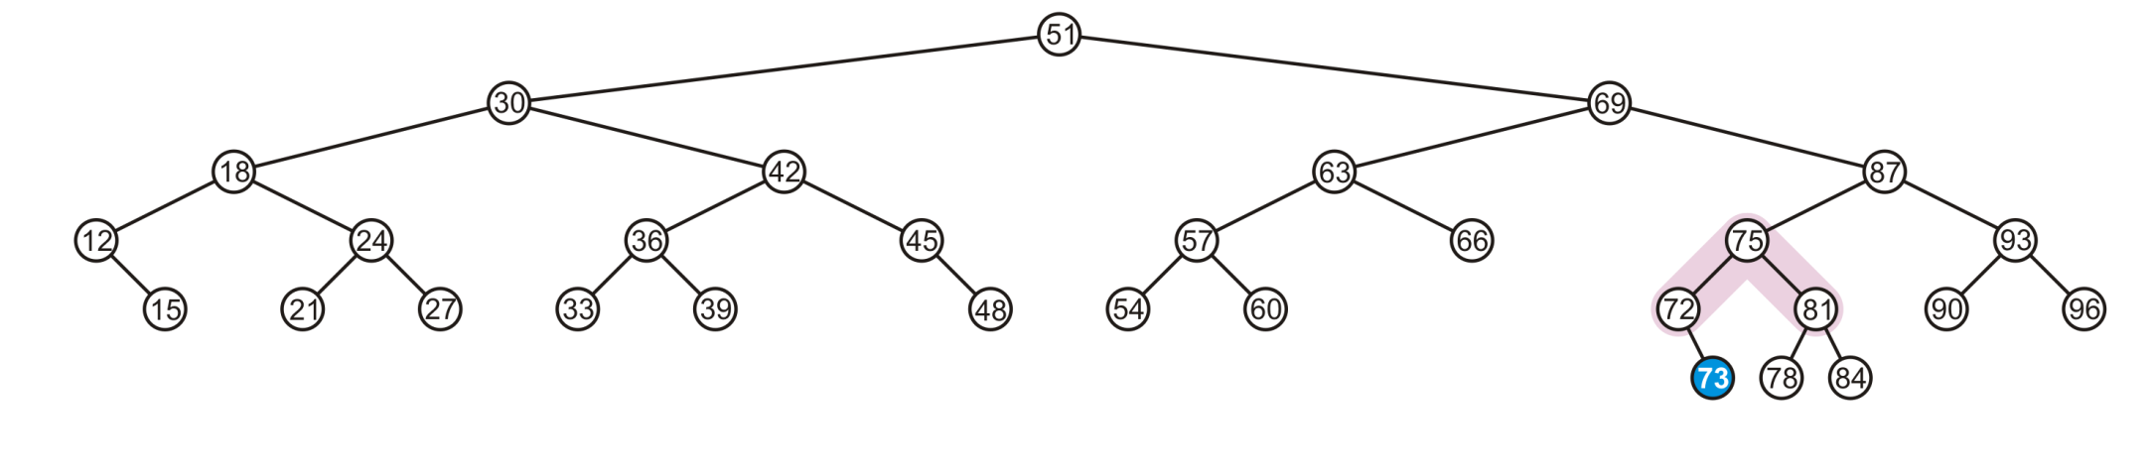
Insertion
The node 81 is unbalanced
A left-left imbalance
Promote the intermediate node to the imbalanced node
75 is that node

Slide 59
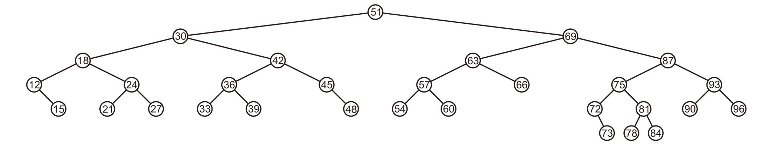
Insertion
The tree is AVL balanced

Slide 60
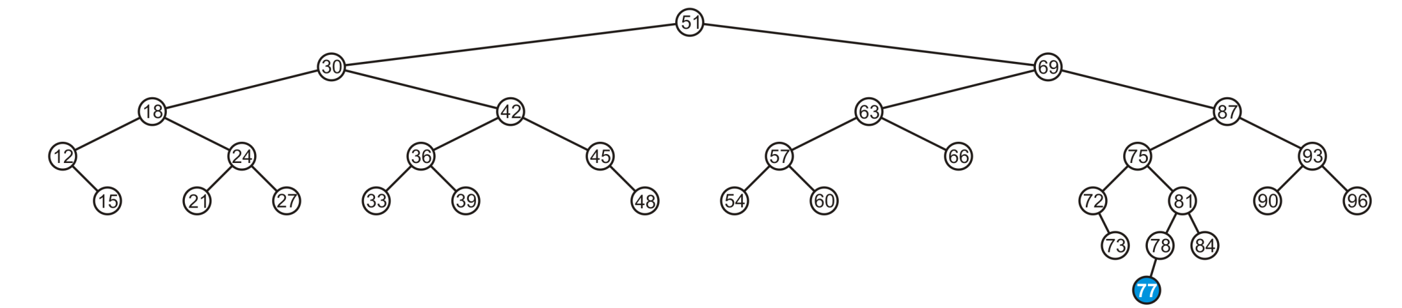
Insertion
Insert 77

Slide 61
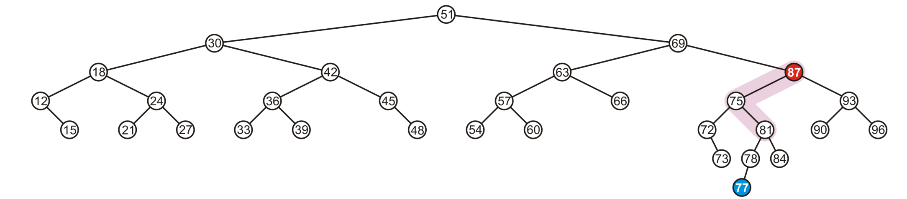
Insertion
The node 87 is unbalanced
A left-right imbalance

Slide 62
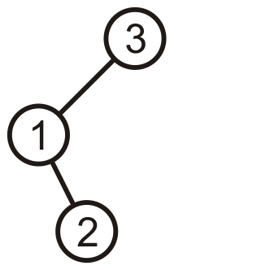
Insertion
The node 87 is unbalanced
A left-right imbalance

Slide 63
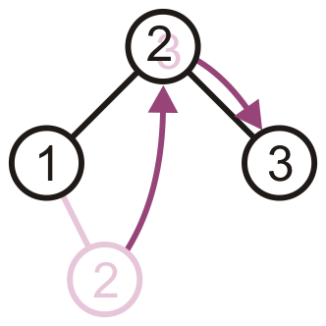
Insertion
The node 87 is unbalanced
A left-right imbalance
Promote the intermediate node to the imbalanced node

Slide 64
Insertion
The node 87 is unbalanced
A left-right imbalance
Promote the intermediate node to the imbalanced node
81 is that value

Slide 65
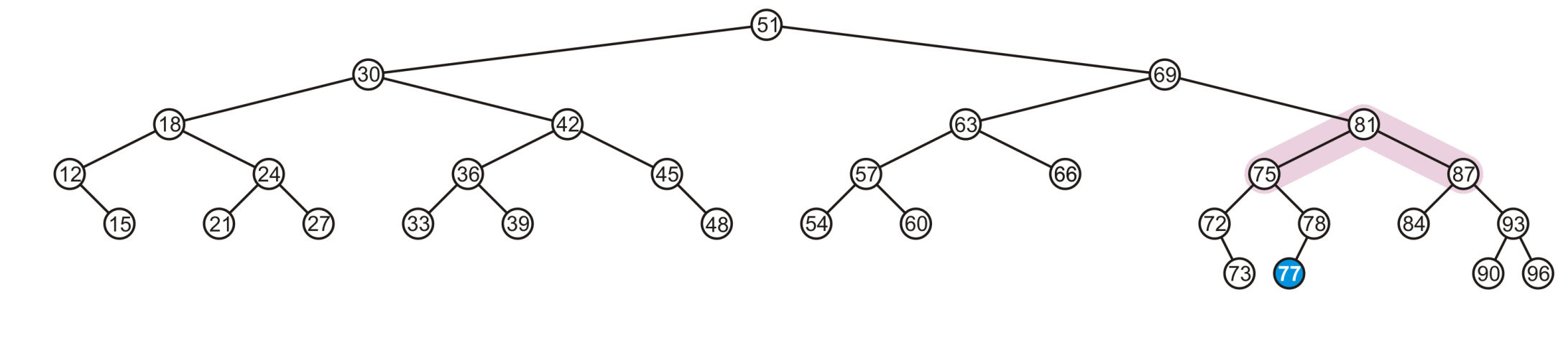
Insertion
The node 87 is unbalanced
A left-right imbalance
Promote the intermediate node to the imbalanced node
81 is that value

Slide 66
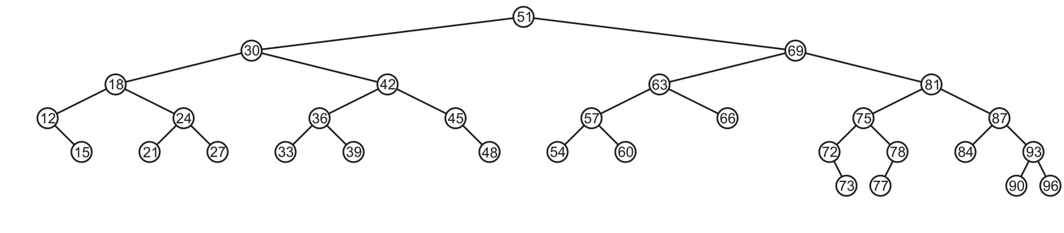
Insertion
The tree is balanced

Slide 67
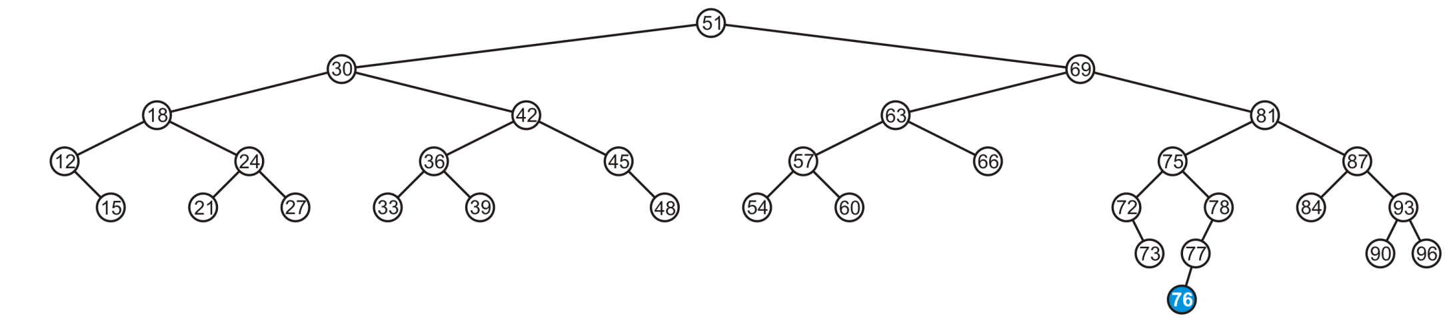
Insertion
Insert 76

Slide 68
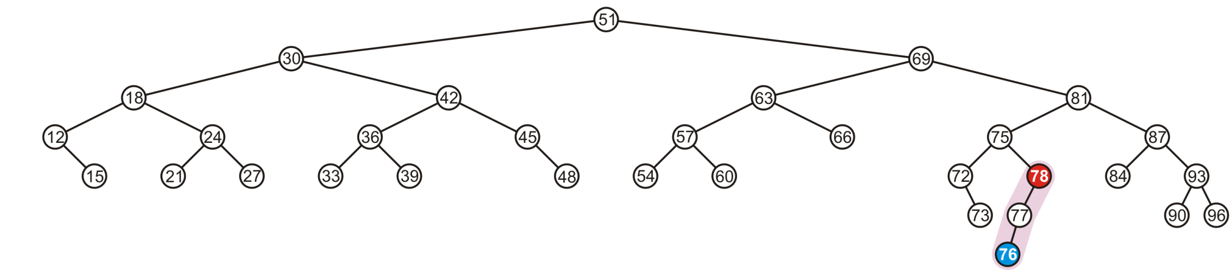
Insertion
The node 78 is unbalanced
A left-left imbalance

Slide 69
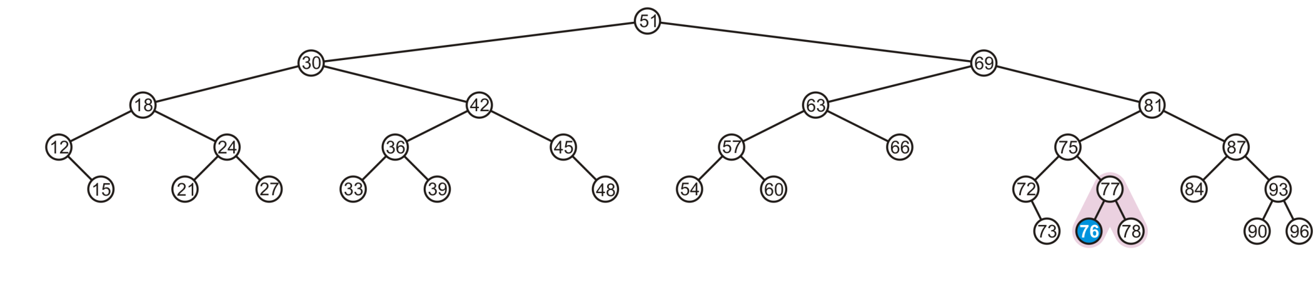
Insertion
The node 78 is unbalanced
Promote 77

Slide 70
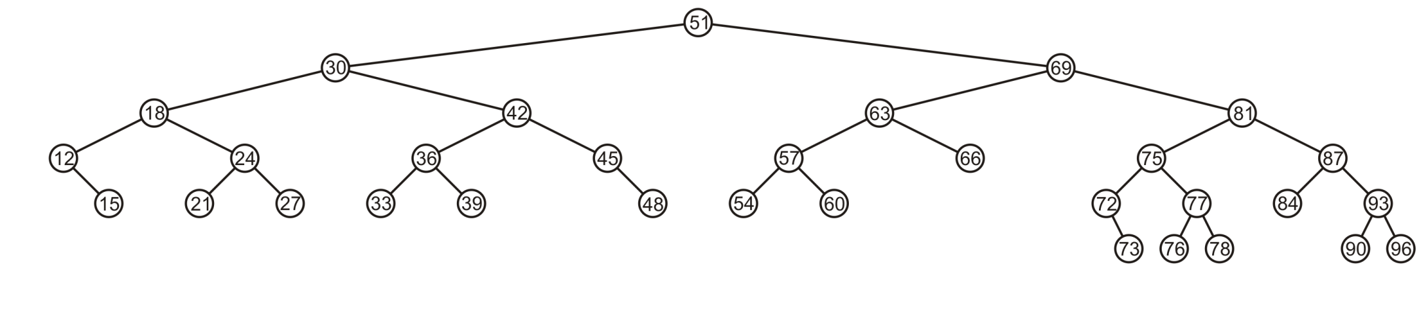
Insertion
Again, balanced

Slide 71
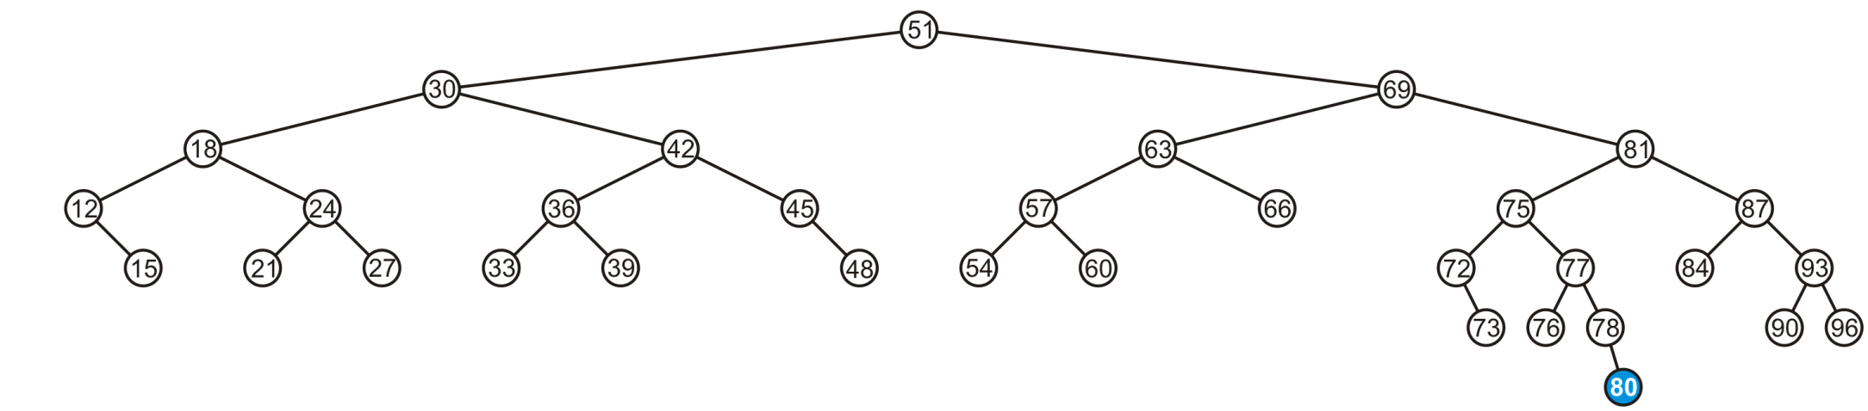
Insertion
Insert 80

Slide 72

Insertion
The node 69 is unbalanced
A right-left imbalance
Promote the intermediate node to the imbalanced node

Slide 73

Insertion
The node 69 is unbalanced
A left-right imbalance
Promote the intermediate node to the imbalanced node
75 is that value

Slide 74

Insertion
Again, balanced

Slide 75

Insertion
Insert 74

Slide 76

Insertion
The node 72 is unbalanced
A right-right imbalance
Promote the intermediate node to the imbalanced node
75 is that value

Slide 77

Insertion
The node 72 is unbalanced
A right-right imbalance
Promote the intermediate node to the imbalanced node

Slide 78

Insertion
Again, balanced

Slide 79

Insertion
Insert 55

Slide 80

Insertion
The node 69 is imbalanced
A left-left imbalance
Promote the intermediate node to the imbalanced node
This is mistake, there are three imbalanced nodes as 51 (root), 69 and 63. We
Need to balance 63 first.
Notes:
51, 30, 75, 18, 12, 15, 24, 21, 27, 42, 36, 33, 39, 45, 48, 69, 63, 57, 54, 60, 66, 73, 72, 74, 81, 77, 87, 76, 78, 80, 81, 87, 84, 93, 90, 96

Slide 81

Insertion
The node 69 is imbalanced
A left-left imbalance
Promote the intermediate node to the imbalanced node
63 is that value

Slide 82

Insertion
Insert 55
No imbalances

Slide 83

Insertion
Again, balanced

Slide 84

Insertion
Again, balanced

Slide 85

Insertion
Insert 70

Slide 86

Insertion
The root node is now imbalanced
A right-left imbalance
Promote the intermediate node to the root
75 is that value

Slide 87

Insertion
The root node is imbalanced
A right-left imbalance
Promote the intermediate node to the root
63 is that node

Slide 88

Insertion
The result is balanced

Slide 89
AVL Trees: Exercise
Insertion order:
10, 85, 15, 70, 20, 60, 30, 50, 65, 80, 90, 40, 5, 55
5/22/2012

Slide 90
Summary: Insertions
Let the node that needs rebalancing be j.
There are 4 cases:
Outside Cases (require single rotation) :
1. Insertion into left subtree of left child of j.
2. Insertion into right subtree of right child of j.
Inside Cases (require double rotation) :
3. Insertion into right subtree of left child of j.
4. Insertion into left subtree of right child of j.
The rebalancing is performed through four separate rotation algorithms.

Slide 91
Implementation
balance (1,0,-1)
key
left
right
No need to keep the height; just the difference in height, i.e. the balance factor; this has to be modified on the path of insertion even if you don’t perform rotations
Once you have performed a rotation (single or double) you won’t need to go back up the tree

Slide 92
Insertion in AVL Trees
Insert at the leaf (as for all BST)
only nodes on the path from insertion point to root node have possibly changed in height
So after the Insert, go back up to the root node by node, updating heights
If a new balance factor (the difference h_{left}-h_{right}) is 2 or –2, adjust tree by rotation around the node
Correctness: Rotations preserve inorder traversal ordering

Slide 93
Delete
In deletion also, we delete the node to be deleted in the same way as we do with a normal binary search tree.
After that, we fix the unbalance of any ancestor node with suitable rotations.
The only thing is that unlike insertion, it might be possible that the unbalance propagates above the tree in deletion which makes us rebalance the ancestor nodes.

Slide 94
Delete in BST
https://www.geeksforgeeks.org/binary-search-tree-set-2-delete/

Slide 95
Delete
Removing a node from an AVL tree may cause more than one AVL imbalance
Like insert, erase must check after it has been successfully called on a child to see if it caused an imbalance
Unfortunately, it may cause multiple imbalances that must be corrected
Insertions will only cause one imbalance that must be fixed

Slide 96
Deletion X in AVL Trees
Deletion:
Case 1: if X is a leaf, delete X
Case 2: if X has 1 child, use it to replace X
Case 3: if X has 2 children, replace X with its inorder predecessor (and recursively delete it)
Rebalancing
5/22/2012

Slide 97

Delete
Consider the following AVL tree

Slide 98

Delete
Suppose we erase the front node: 1

Slide 99

Delete
While its previous parent, 2, is not unbalanced, its grandparent 3 is
The imbalance is in the right-right subtree

Slide 100

Delete
We can correct this with a simple balance

Slide 101

Delete
The node of that subtree, 5, is now balanced

Slide 102

Delete
Recursing to the root, however, 8 is also unbalanced
This is a right-left imbalance

Slide 103

Delete
Promoting 11 to the root corrects the imbalance

Slide 104

Delete
At this point, the node 11 is balanced

Slide 105

Delete
Still, the root node is unbalanced
This is a right-right imbalance

Slide 106

Delete
Again, a simple balance fixes the imbalance

Slide 107

Delete
The resulting tree is now AVL balanced

Slide 108
Pros and Cons of AVL Trees
Arguments for AVL trees:
Search is O(log N) since AVL trees are always balanced.
Insertion and deletions are also O(logn)
The height balancing adds no more than a constant factor to the speed of insertion.
Arguments against using AVL trees:
Difficult to program & debug; more space for balance factor.
Asymptotically faster but rebalancing costs time.
Most large searches are done in database systems on disk and use other structures (e.g. B-trees).
May be OK to have O(N) for a single operation if total run time for many consecutive operations is fast (e.g. Splay trees).

